Slide 1
Faculty Attendance system
Prepared By: Guided By:
Dax Patel (18CE070) Prof. Ronak Patel
Jay Patel (18CE077)
Ritul Patel (18CE084)
Shail Patel (18CE086)

Slide 2
Table of Contents
Introduction
Description
Tools and Technology
Methodology used
Functionality
Flowchart
Demo

Slide 3
INTRODUCTION
Humans have always had an innate ability to recognize and distinguish between faces. Now computers are able to do the same, opening a opportunity for the advancement of human civilization.
A face recognition system is a biometric technology used for mapping facial features and patterns for the purpose of identity storage and verification. It is being widely used to improve access and security, allows payments to be processed without physical cards.
It also enables criminal identification, strengthening the pillars of law and enforcement. It also has started breaking natural barriers by helping blind or low vision users recognize faces and their surroundings.

Slide 4
Project DESCRIPTION
This project aims to automate the traditional attendance system where the attendance is marked manually.
It also enables an organization to maintain its records like in-time, out time, break time and attendance digitally.
Digitalization of the system would also help in better visualization of the data using graphs to display the no. of employees present today, total work hours of each employee and their break time.
Its added features serve as an efficient upgrade and replacement over the traditional attendance system.

Slide 5
MOTIVATION
Although we can find many other identification and verification techniques, the main motivation for face recognition is because it is considered a passive, no intrusive system to verify and identify people.
No, this type of project is not developed earlier because we are came up with de-centralised system.
By looking in our university that there is a long queue of faculty members in that old attendance system which is done using fingerprint, we got an idea to develop such a system which takes the attendance using face detection.

Slide 6
TRADITIONAL aTTENDANCE SYSTEM
OUR ATTENDANCE SYSTEM
Less Accuracy in particular case
Costly piece of solution
Hard to visualize
Less expensive
One step ahead
Data visualization

Slide 7
TOOLS & TECHNOLOGY USED
Python - Programming language.
OpenCV - Image processing.
Dlib - Library used for Facial Alignment,Landmark Detection.
Face_recognition - library by Adam Geitgey - which wraps around Dlib’s facial recognition functionality, making it easier to work with.
Matplotlib, Seaborn, Numpy, Pandas - Data Handling and Visualisation
Django - web development
HTML, CSS - front end development
SQLite3- Database Management.

Slide 8
Methodology

Slide 9
Part 1 : Face Recognition
Unknown Face
Face detection, landmark detection, alignment
Generate embeddings using face _ recognition library
Classify unknown embedding
9

Slide 10
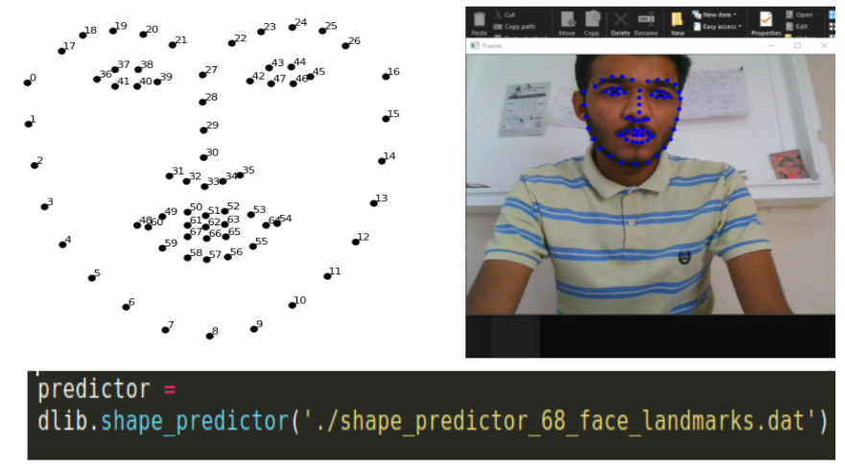
Landmark Detection Using Dlib’s 68 Point Shape Predictor

Slide 11
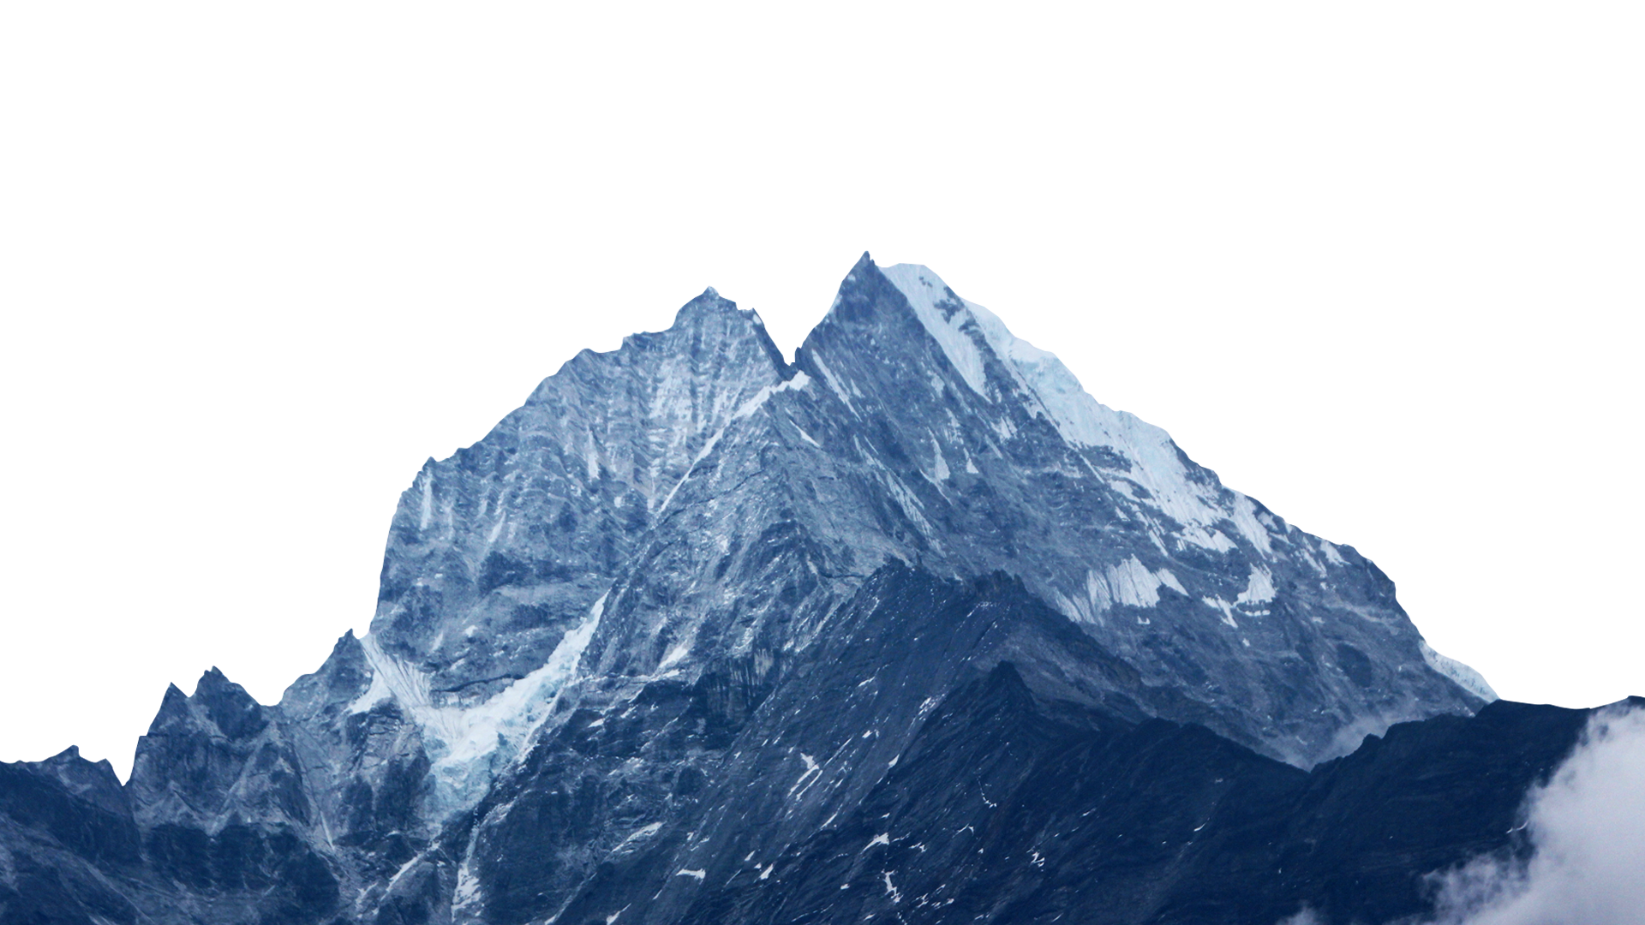

ALIGNMENT
Goal : To warp and transform the input image (coordinates) onto an output coordinate space, such that, each face in the output coordinate space be:
Be centered in the image.
Be rotated that such the eyes lie on a horizontal line (i.e., the face is rotated such that the eyes lie along the same y-coordinates).
Be scaled such that the size of the faces are approximately identical.
Facial recognition algorithms perform better on
aligned faces.

Slide 12
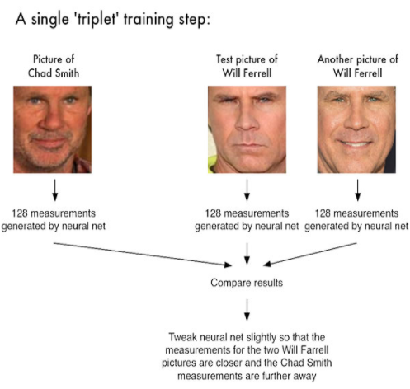
Extracting 128-d embeddings
Available models-
face_recognition by Adam Geitgey
nn4_small2 model of the OpenFace project
Triplet loss is minimised

Slide 13
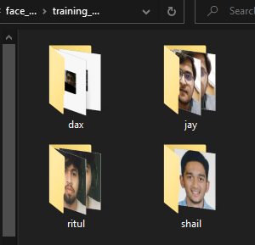
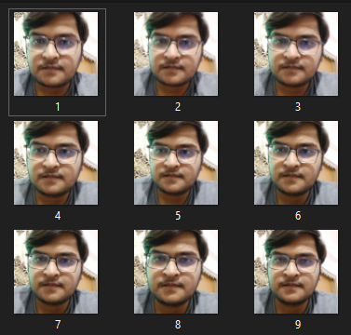
TRAINING
Dataset created using create dataset functionality of the web application
128-d embeddings generated for each image
Embeddings stored in a dictionary
A Linear SVM loaded, and the embedding data “fitted” onto it.
SVM state stored onto the machine in a “.sav” file using pickle library in python.

Slide 14
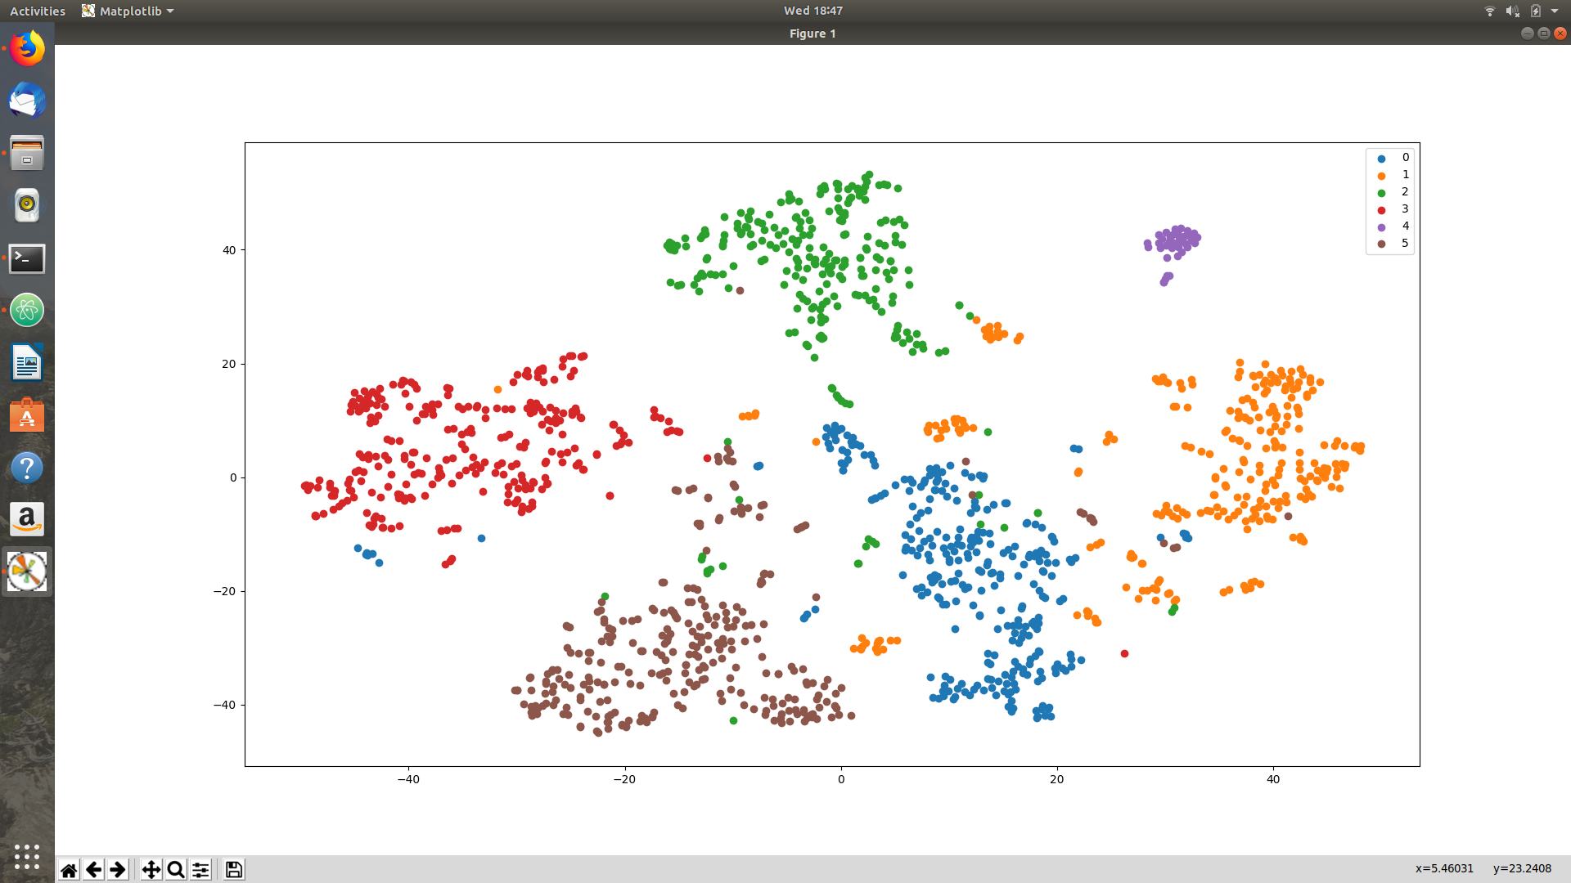
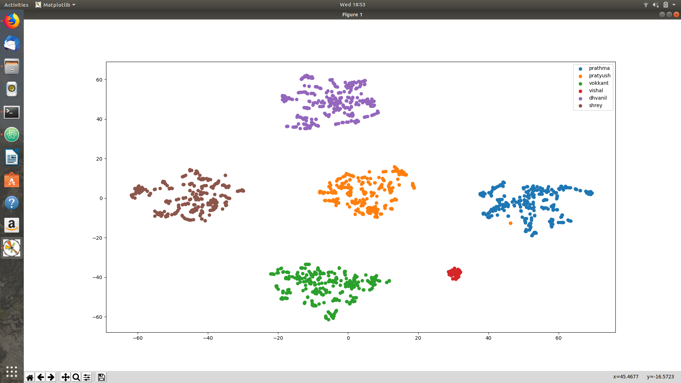


Data Visualisation (Clustering of embedding data)
NN4 SMALL2 MODEL
FACE RECOGNITION by Adam Geitgey
Results :
Much sharper clustering using face_recognition.
NN4 model took approximately 20 seconds to load.
Face_recognition chosen for our project

Slide 15
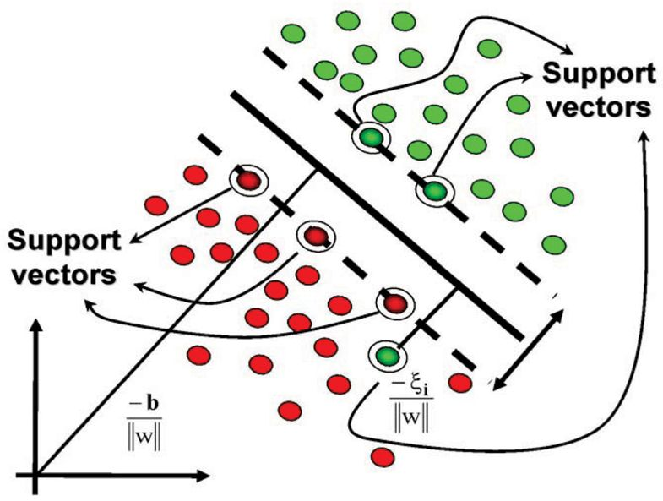
Classification using Support Vector Machine (SVM)
Support-Vector Machines are supervised learning models with associated learning algorithm that analyze data used for classification and regression.
Support-vector clustering algorithm applies the statistics of support vector and categorizes unlabeled data.
15

Slide 16
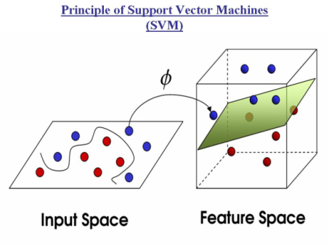
Principle of support vector machines (svm)
For more complicated case -
It converts the input space into a multidimensional space called feature space were it can easily distinguish between support vectors.
In our case it is 128-dimensions.

Slide 17
02
Web development
Framework- Django
HTML
CSS
Python
Database- SQLite3 - Well integrated with Django’s ORM

Slide 18
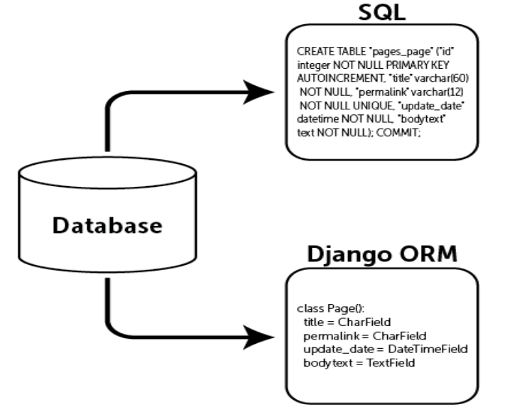
Object Relational Mapping, Models and Databases

Slide 19
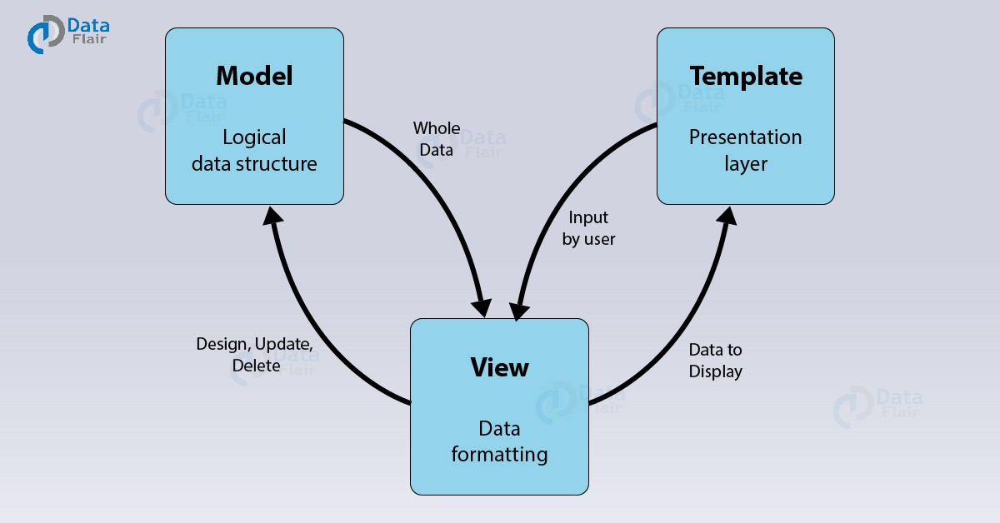
Mtv architecture

Slide 20
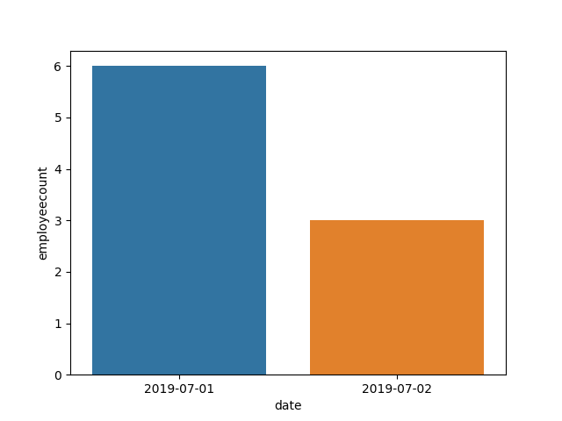
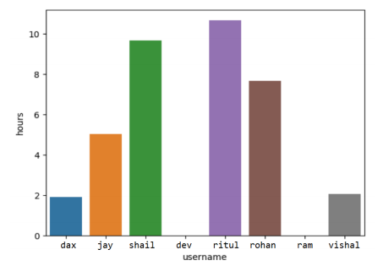
Data Visualisation
Seaborn
django-pandas
matplotlib

Slide 21
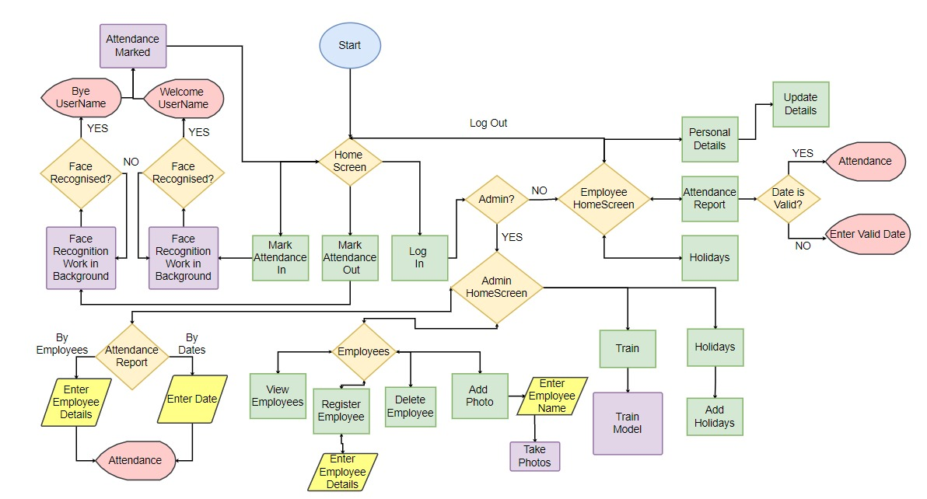

Slide 22



Slide 23

tHANK yOU

